Slide 1
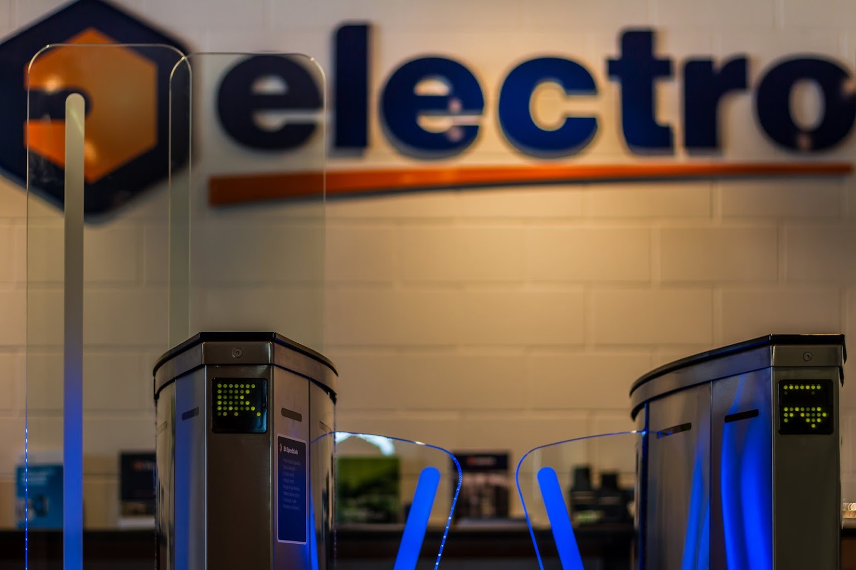
Company Profile Electro Automation
Electro Automation
EA House
Damastown Business Park

Slide 2
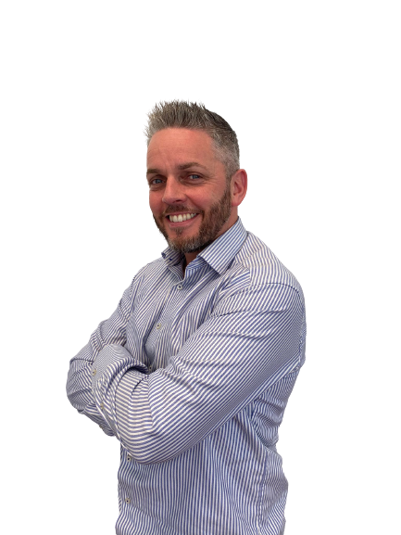
About Us
The Beginning
Founded in 1984, Electro started with just a vision to provide exceptional automation solutions along with top quality equipment
For over three decades, we have been recognised as Ireland's Premier Automation Specialist, setting the standard in our industry.
Continued Expansion
Within a year, continued growth prompted the establishment of Electro Automation (NI) Limited. Based in Lisburn, Northern Ireland.
Multinational
Electro then acquired a majority shareholding in Perimeter Security Group. Now known as EA Group (UK) Limited.

Slide 3
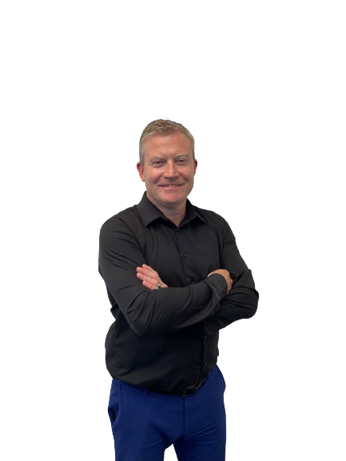
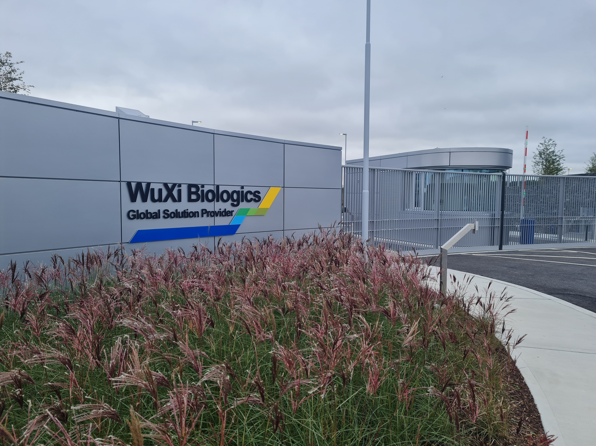
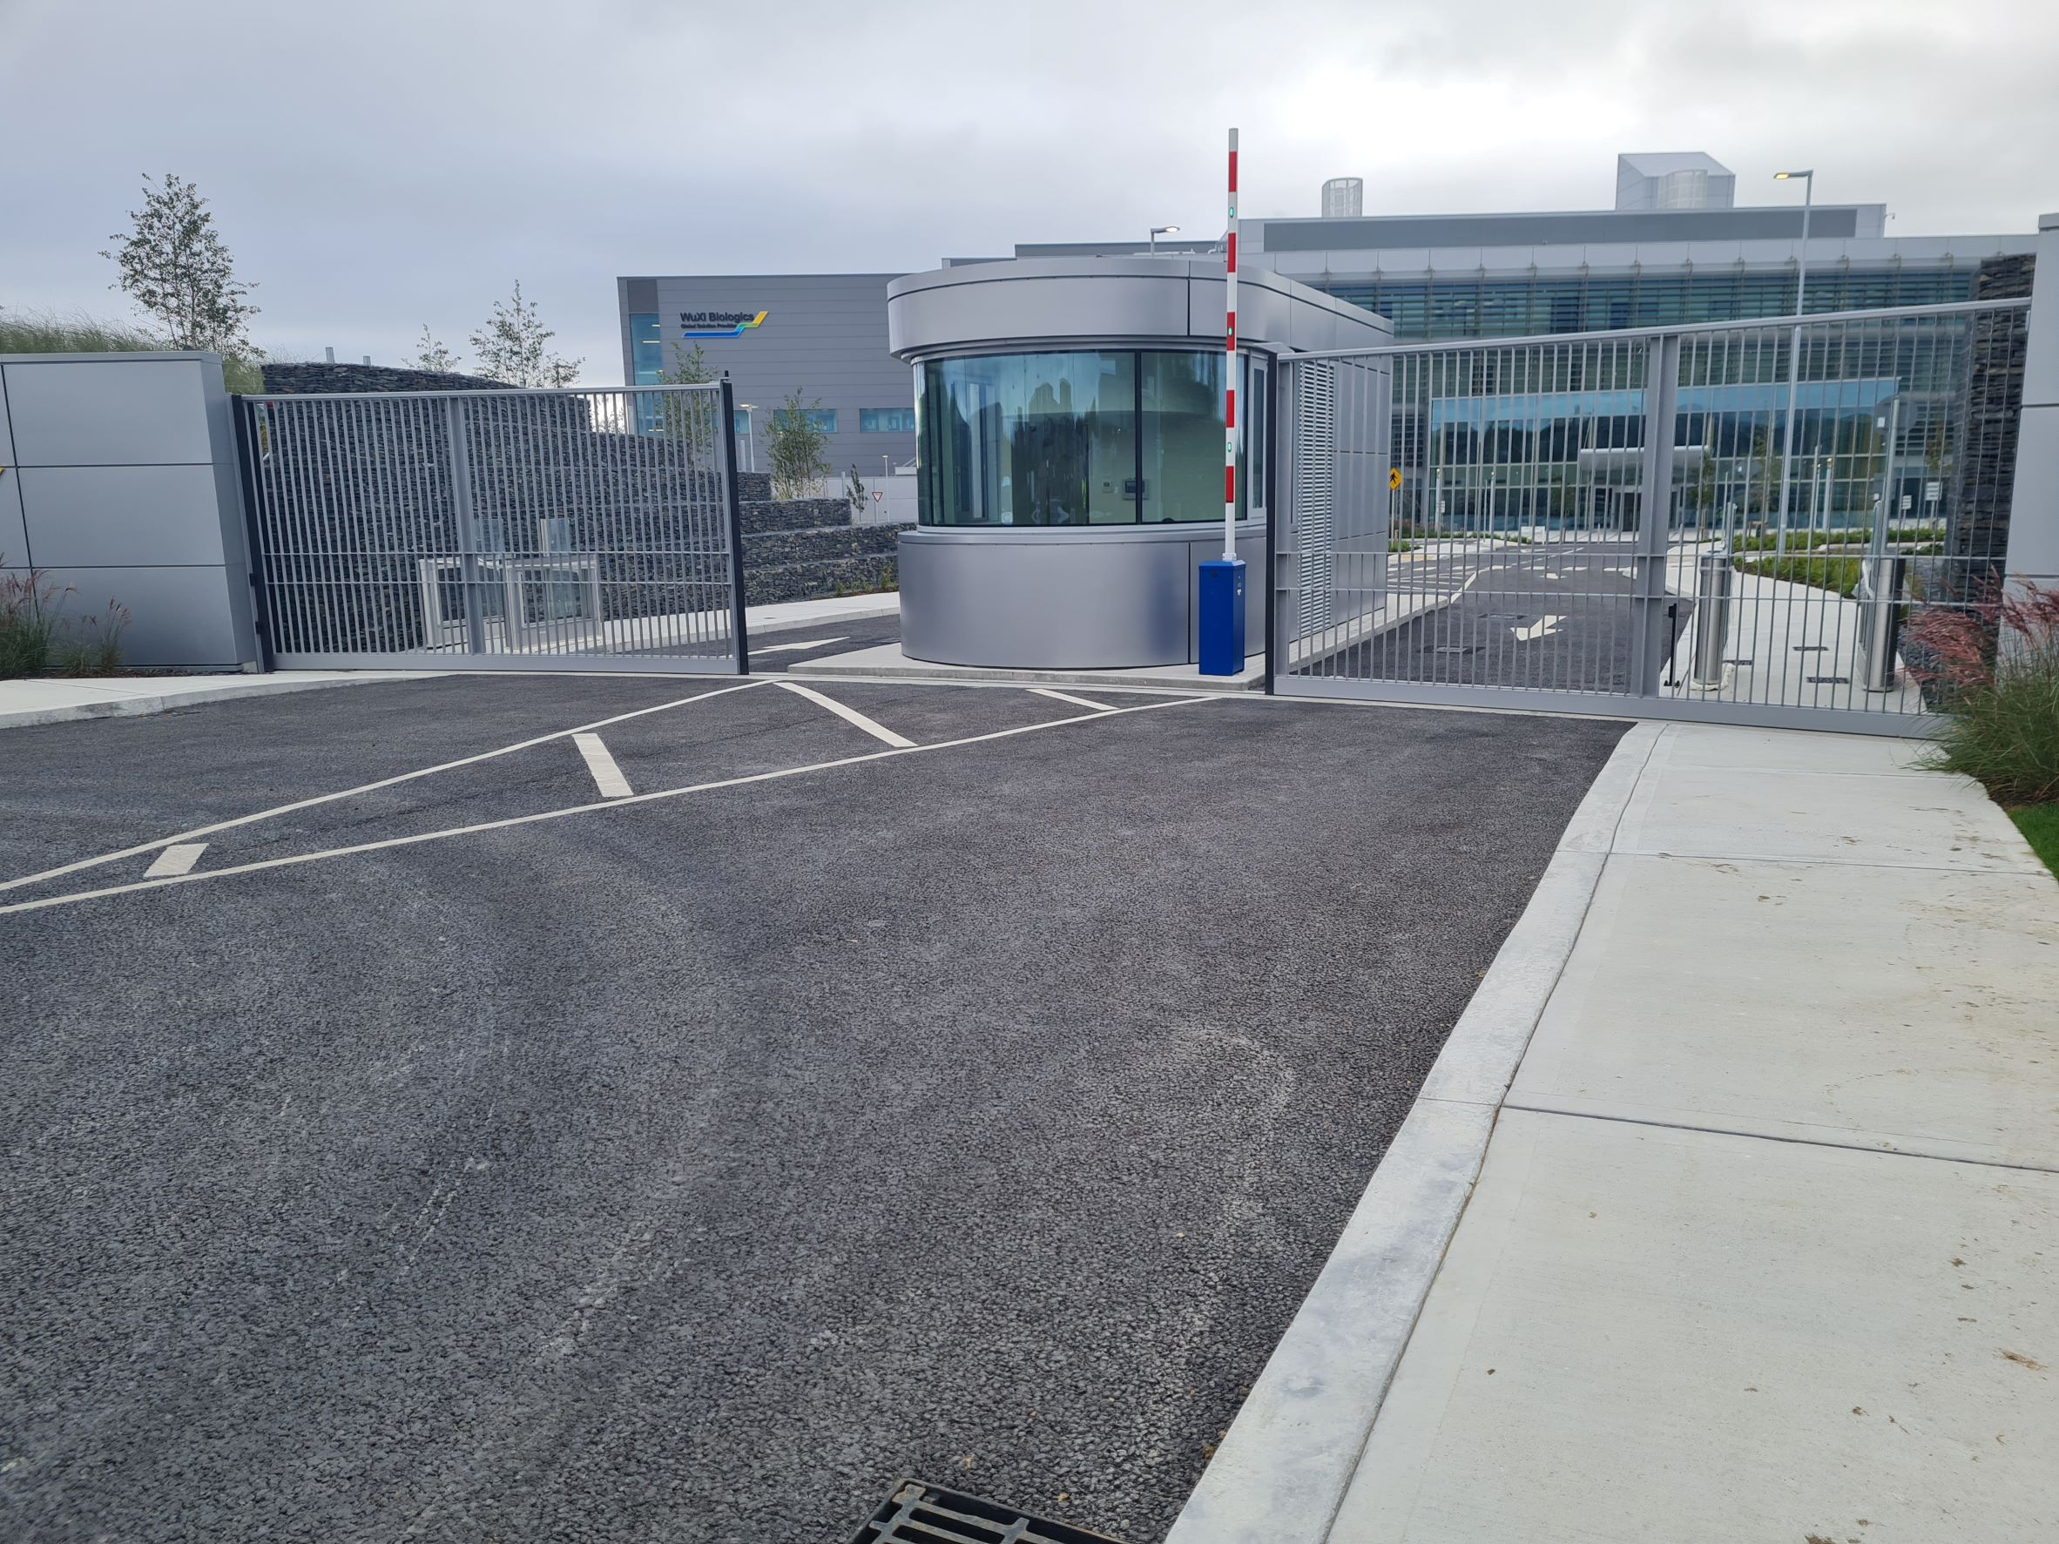
EDS
Since its foundation in 1992 through to the present day, EDS skills, dedication and expertise, together with their core values have provided the building blocks that support growth into the future. EDS also have strong experience in supplying to countries outside of the UK. EDS employ highly skilled installation, service and support teams, giving total control over the entire supply chain. This enables EDS to offer a superior service guarantee, resulting in better quality, improved delivery and lead-times and unrivalled response, with 24-hour emergency service coverage

Slide 4
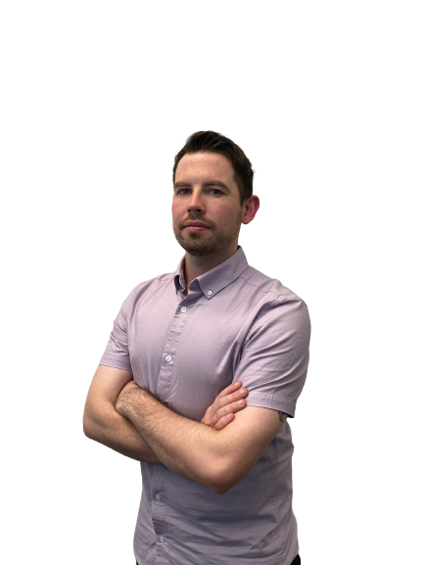
NEAT Premium Aluminium Gates
The Gates
Gates are manufactured to order to exactly match client specifications in a state-of the-art facility utilising cutting edge fabrication and assembly methodology.
Following years of research, hands on experience and reacting to growing demand, Electro created NEAT Premium Aluminium Gates, a new Dublin based manufacturing plant as a separate standalone company. NEAT has its own factory, staff and using the latest automated machinery manufactures a purpose designed range of exceptional aluminium gates and railings. All NEAT products are available to trade and retail.
The Quality
Gates are mechanically fixed and powdercoated, with paint guarantees on ocean treatment of up to 10 years.
Secure & Stylish
With our unique high quality stainless steel adjustable hinging systems, our extremely well-made gates ensure trouble free, low maintenance operation with outstanding longevity.

Slide 5
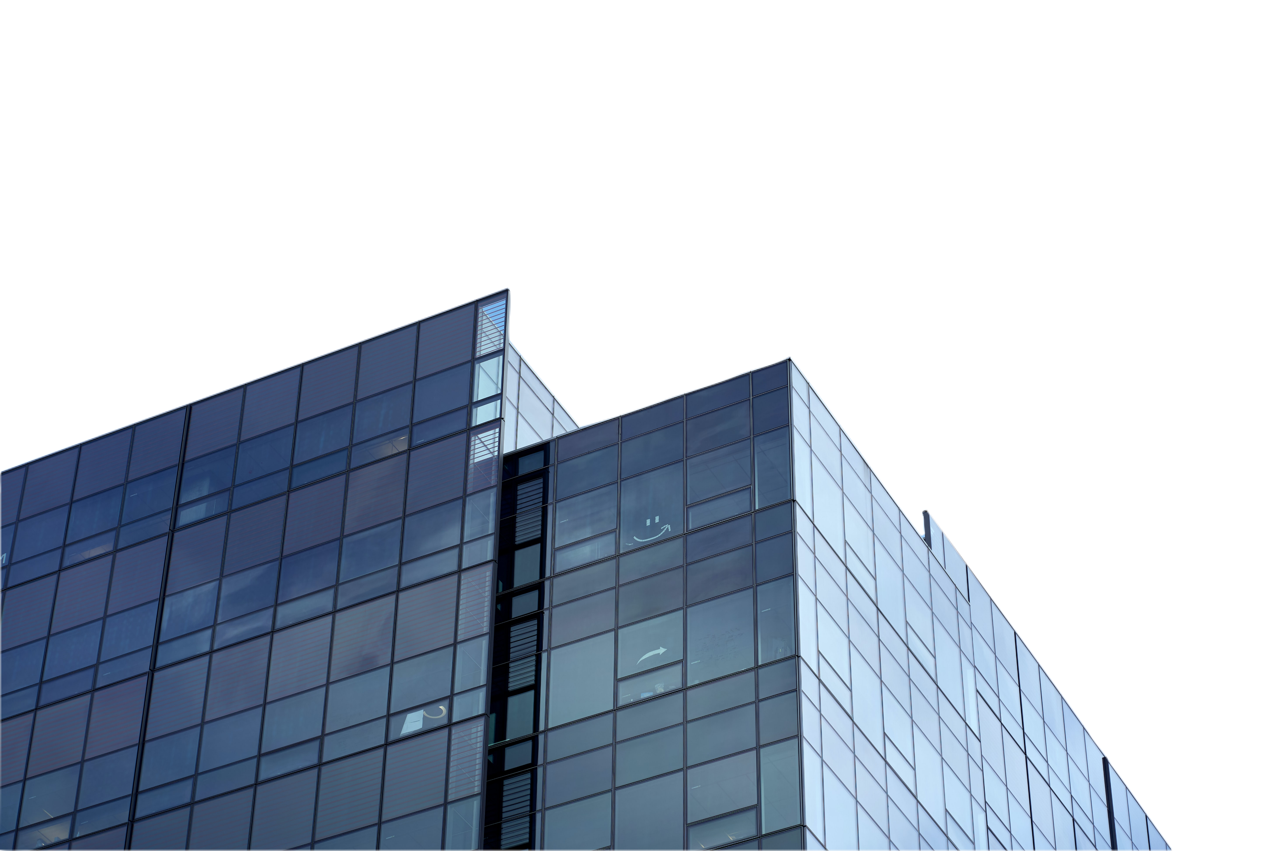
Our Vision
When we provide a fixed quotation, we guarantee that it is a workable solution.
We are a progressive locally owned Group of Companies with a determination to be the best at what we do. Centred loosely around automation systems, the group is widely recognised as being Irelands leading provider of automation and Intelligent Transport Services. With continuous growth during our 35+ years in business, we don’t set ourselves limits, and are determined to continue our expansion in this growing sector.
We protect your interests by ensuring that each project is completed with minimum disruption, and most importantly we stand over our products and every contract we complete.
Our reputation and integrity are extremely important to us.
Fuelled by innovation, Electro Automation is dedicated to shaping the future. Our commitment to cutting-edge technology and unparalleled service is paving the way for a more efficient tomorrow across industries globally

Slide 6
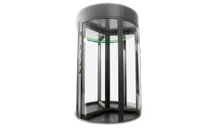
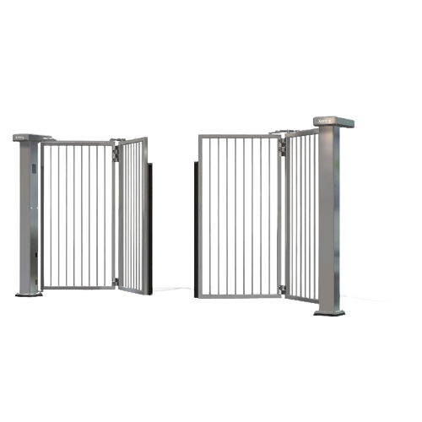
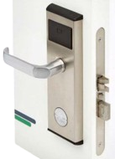
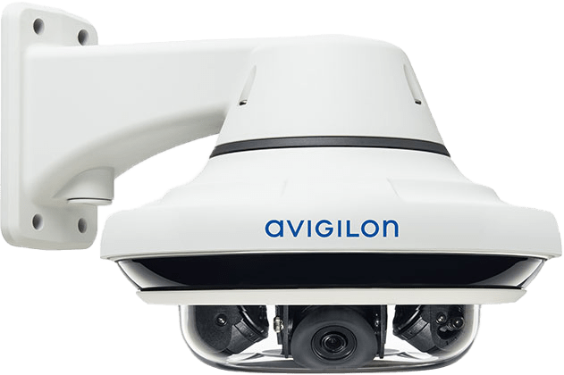
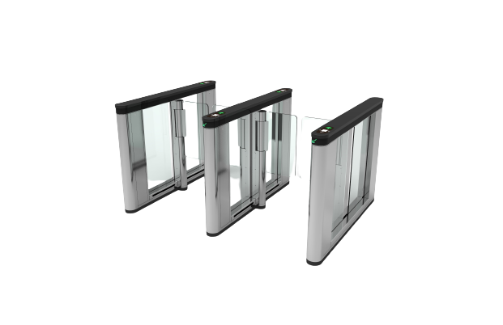
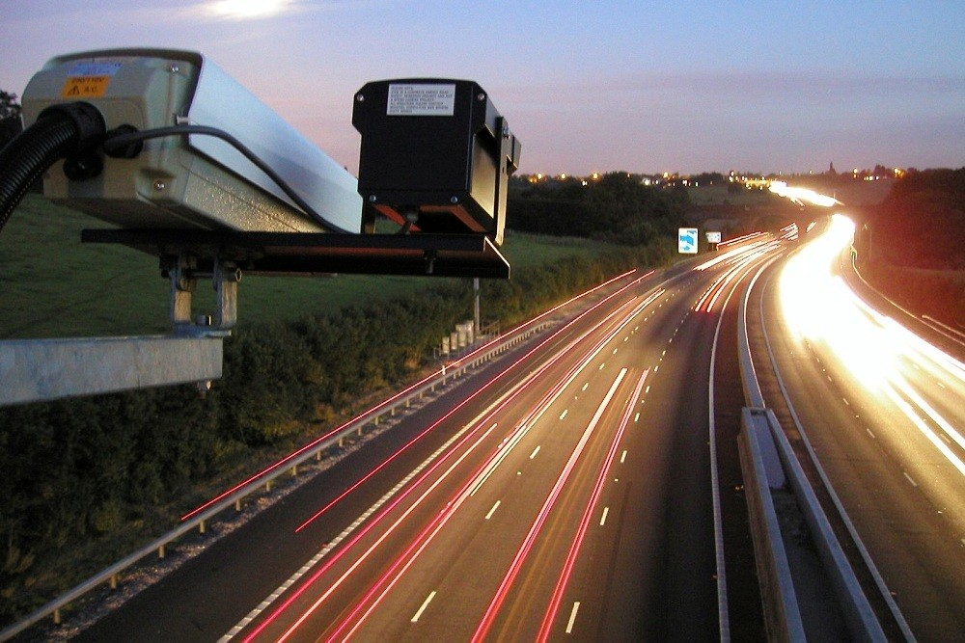
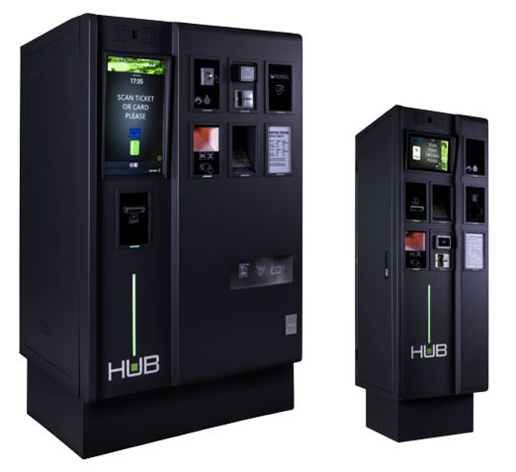
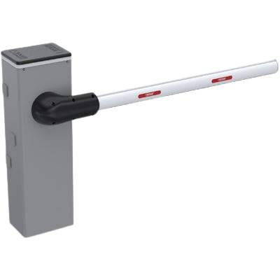
Our Solutions
Doors & Automation
Gates & Automation
Our specialist doors division offers an unsurpassed level of expertise with a full design, manufacture, installation and maintenance service for sliding, revolving and swing doors. Nationwide coverage, locally supported.
Automatic gates combine security with convenience and are accepted as one of the most efficient methods of perimeter control.
Access Control
Video Surveillance
Control who comes into your premises, at what time and at what entrance. We can improve your security and health and safety, reduce losses, and greatly reduce your costs and staffing levels. Access Control can be linked to barriers, doors and gates
Monitor your building with a choice of On prem or cloud-based video surveillance. We use a range of AI search technology to make searching for items or people easy
Turnstiles
ITS
Our superb range of high-quality turnstiles are truly exceptional. Make an impressive entrance with Electro Automation and take control of your entrance area in a low cost secure and attractive environment. .
Electro constantly innovates in the areas of Intelligent Transport Equipment, Data Capture and Analytics, Car Parking, transport systems, and more recently CAV and EV Charging, all brought together within our ITS division.
Car Parking Systems
Traffic Control Barriers
We are the leaders in car park control. Our HUB Parking Technology parking systems are exceptional, and when combined with Electro’s unparalleled 24/7 technical support .
Automatic Bollards provided by Electro provide a high degree of security in a discreet and aesthetically pleasing manner. All of our automated barriers can operate independently or can integrate seamlessly with Access Control
Notes:
Carparking – Qpark, Park Rite, Euro Carparks, Jury Doyle Hotel Group, Crowne Plaza, Clarion, Hilton, Portrane National Forensic Mental Hospital

Slide 7
Service & Maintenance
Regularly maintained equipment will reduce operating costs and helps eliminate large, unexpected bills
This division supplies all of Electro’s customers with an excellent maintenance service across all equipment types. These customers can be a small single barrier user, a large multiple access control and gate automation customer such as a high-security site (an embassy or prison for example), or a very large car parking customer. All their requirements vary greatly from a cost-effective next day response, to an immediate response within a guaranteed time scale.
Ensures your equipment is working efficiency and doesn’t contravene any H&S Regulations
Ensures that the safety features are in correct working order which reduces the risk of insurance claims
Our maintenance team will attend your property to ensure your equipment is serviced regularly. Our service team are on call 24 hours a day to resolve any issues that may arise in or out of usual hours, same day call out if logged before 10am.

Slide 8
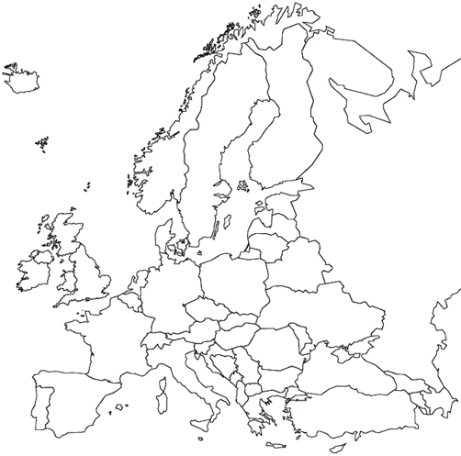
Our Markets
Electro Automation have multiple branches across different countries. All with different needs and customers
Dublin
Lisburn
Birmingham
Surrey
Germany

Slide 9
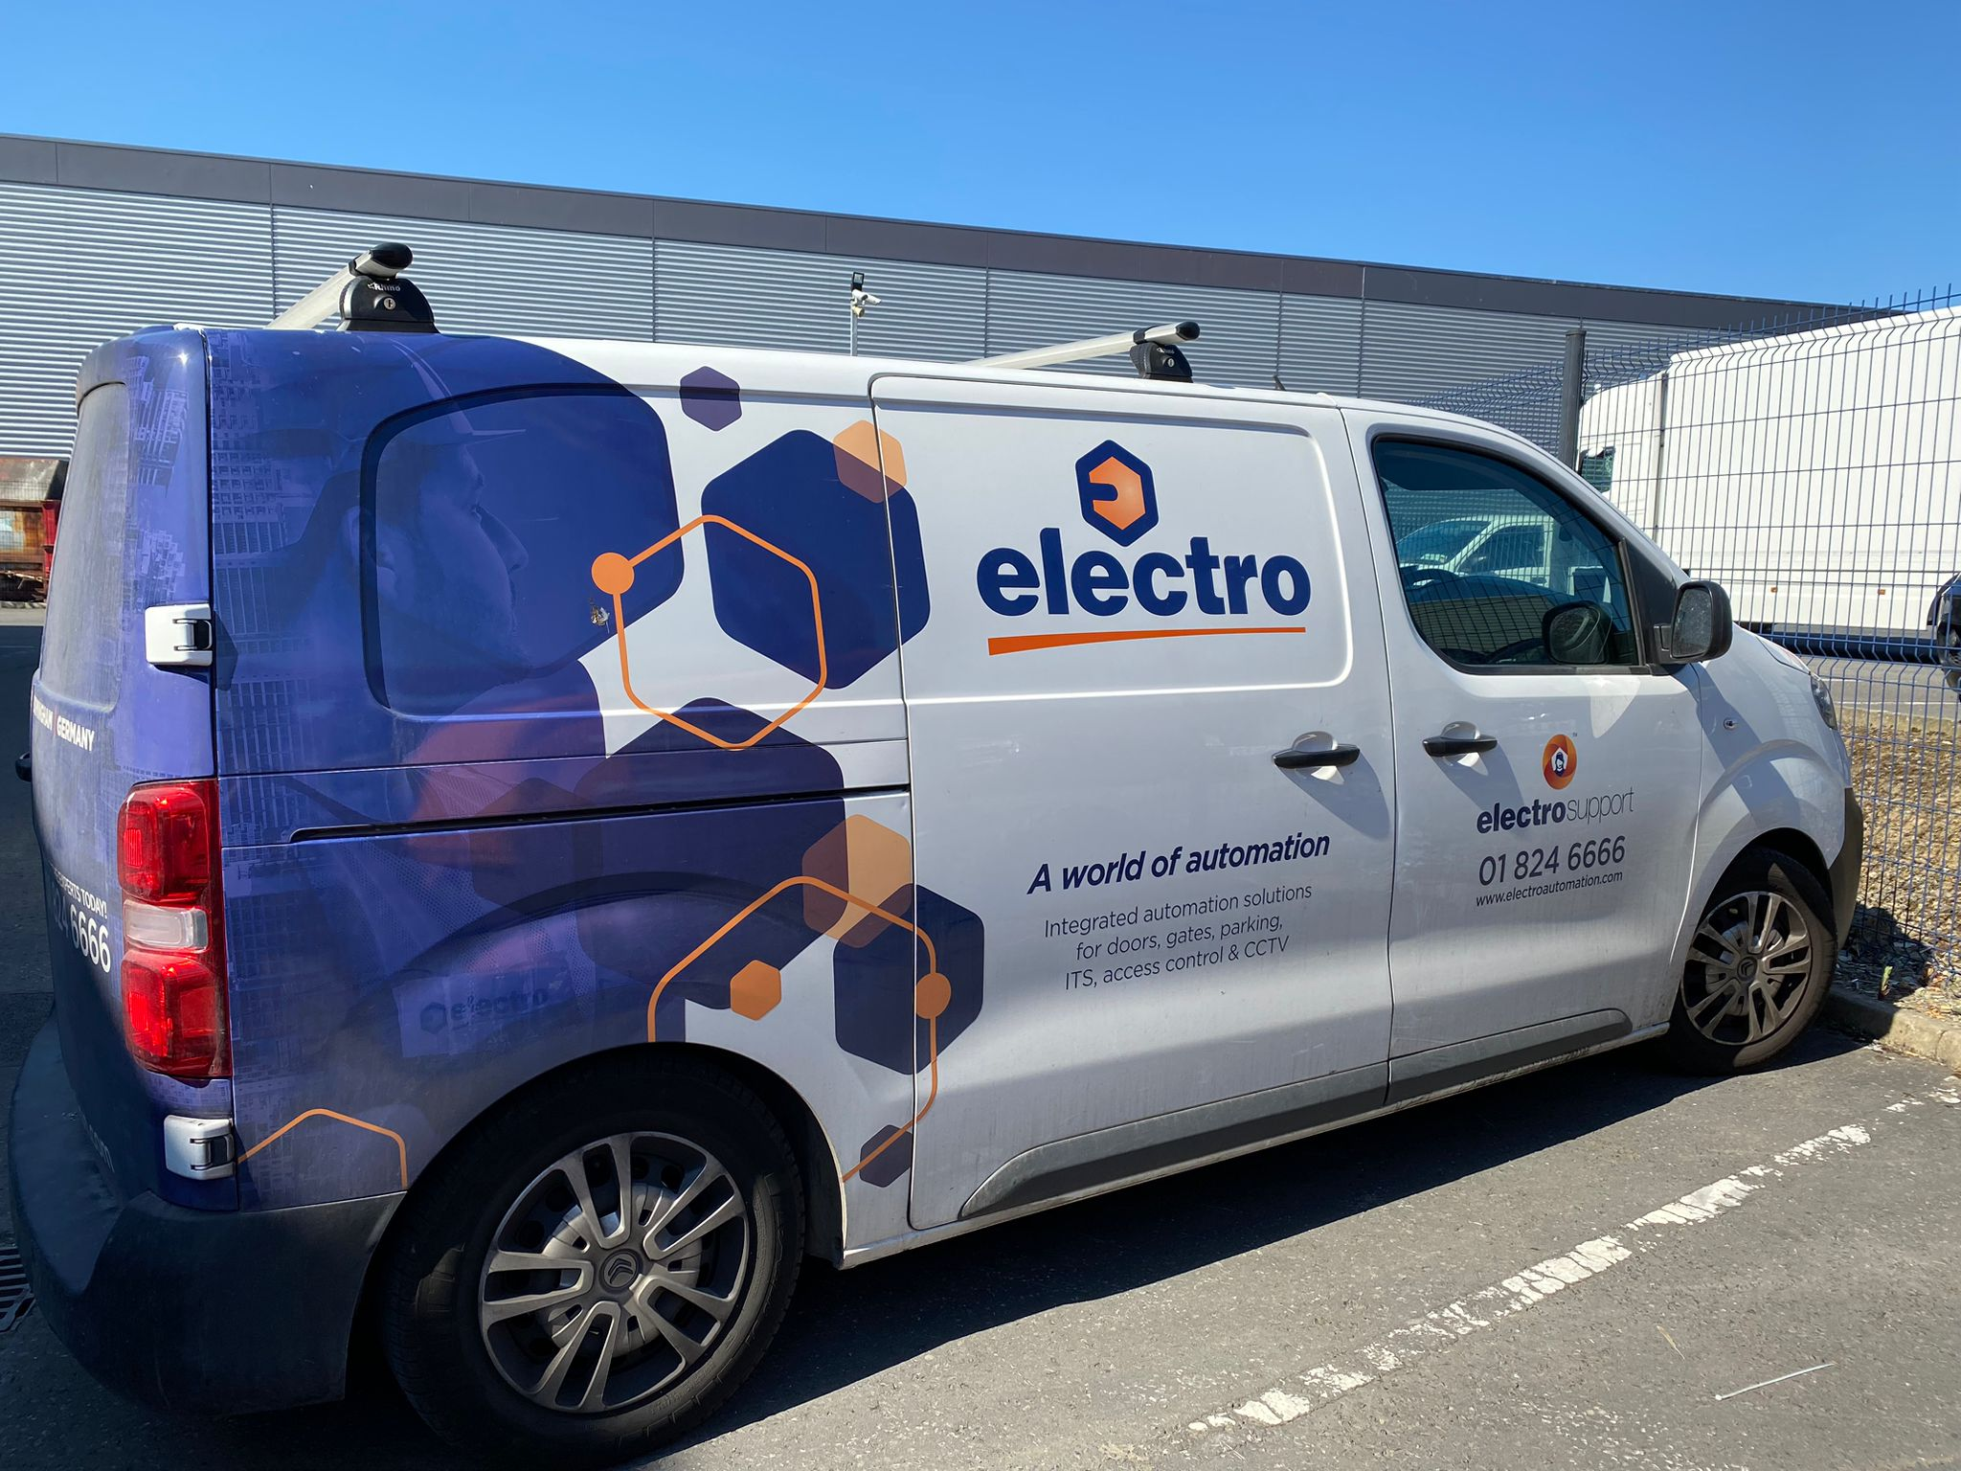
Recent project including the installation & automation of 2 swing gates and 1 sliding gate. Replacing 3 very unreliable, poorly engineered sectional doors installed by a previous company. Thanks to Electro Automation Ltd for an excellently executed job.
Electro Automation have provided Meath County Council with automatic barriers and payment systems at a number of installations. We have found them to be financially competitive, technically competent and they provide a reliable back up service where issues may arise.
What our customers say
Electro Automation have installed and maintained our parking equipment for 10 years. We recently upgraded our system to the latest barcode technology and the project was a huge success. The project was well planned and delivered on time and within budget.
We have worked with Electro automation for many years. When we came to the major decision that our customers required 24/7 service 365 days a year, we had no hesitation in forming a strategic linkage with Electro to provide the electrical commissioning and service requirements for our domestic and commercial gate installations. Their service is first class, and it is a great comfort to our clients to have a reliable and proven service partner

Slide 10
Electro Automation, sustainability is a core value that guides our business practices. We are committed to minimizing our environmental impact and promoting sustainable solutions throughout our operations. We prioritize resource efficiency, waste reduction, and responsible energy consumption in our manufacturing processes. We also strive to incorporate eco-friendly materials, such as recycled or renewable materials, in our products whenever possible. Additionally, we actively seek opportunities to support and engage with local communities, promoting social sustainability through initiatives such as employee volunteering, community partnerships, and charitable donations.
As part of our evolving environmental policy, Electro Automation is proud to announce that we are a Cool Partner for CloudForests.
As a CloudForests Cool Partner, Electro Automation is playing its part in planting trees across 5 forests spread across Ireland’s Wild Atlantic Way.
Click HERE for our Electro Automation ESG document.

Slide 11
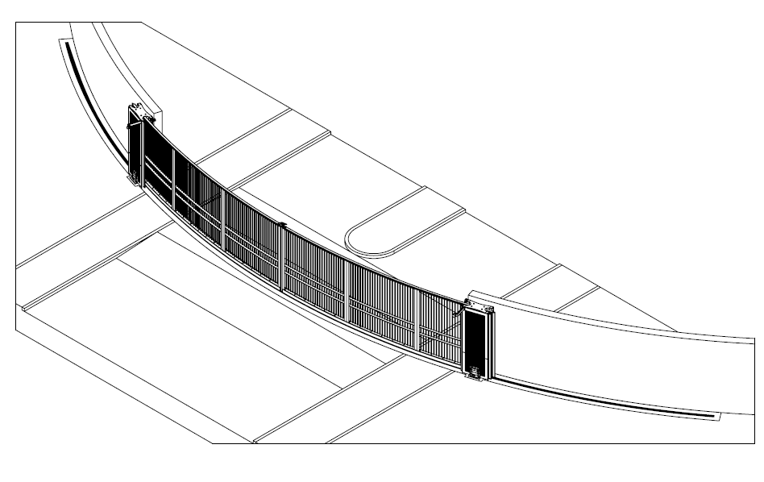
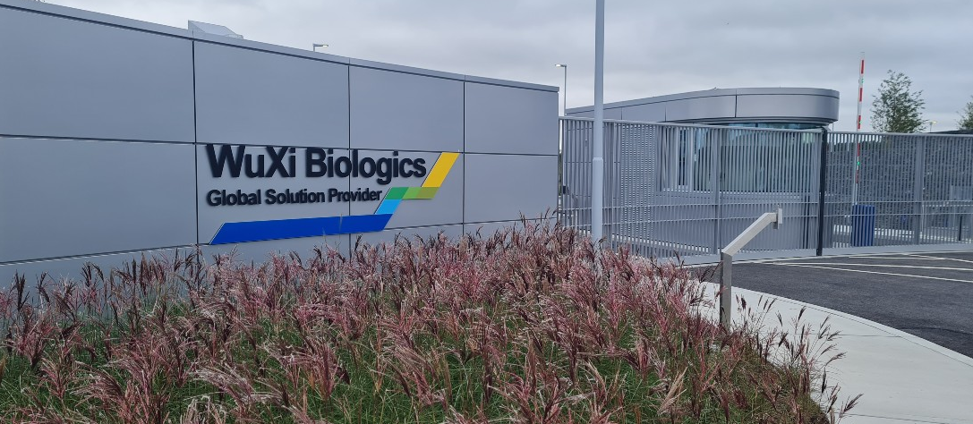
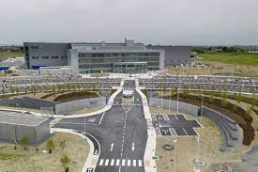
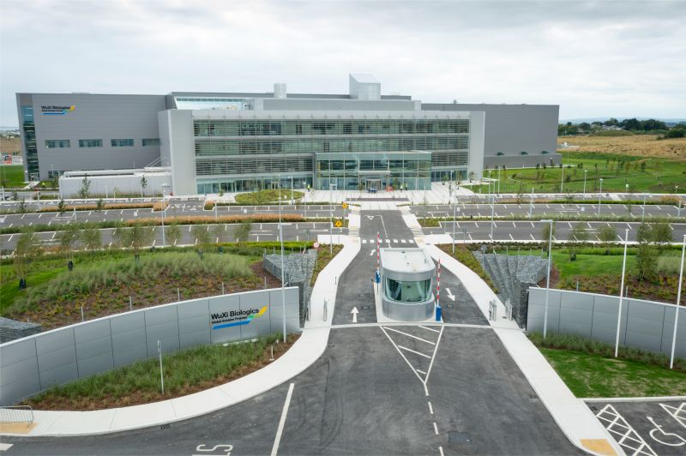
Case Study
Project: Creation of a 14-meter-wide double sliding curved gate, blending aesthetics and security for a prestigious Irish estate.
Challenges:
Aesthetics: Crafting a gate that seamlessly matched the estate's architecture.
Automation: Integrating advanced automation technology for smooth movement.
Security: Maintaining security standards while upholding elegance.
Solution:
Architectural Vision: Meticulously designed curvature in sync with surroundings.
Automation Integration: Collaborated with experts for seamless sliding and locking.
Materials: Blend of durable steel and ornamental elements.
Results:
Aesthetic Enhancement: Gate became an architectural centerpiece, enhancing entrance.
Effortless Automation: Double sliding panels moved smoothly, offering convenience.
Robust Security: Gate provided a secure barrier without compromising on appearance.
Conclusion:
The project showcased successful fusion of visionary design and technology, resulting in a landmark curved gate that elegantly marries aesthetics with security. The estate's entrance stands as a testament to innovative architectural solutions.

Slide 12
Contact us
info@electroautomation.com
01 824 6666
www.electroautomation.com
www.linkedin.com/company/electro-automation-ltd-/

